Slide 1
Use Modal form for CreatePopup API
Eric Dong

Slide 2
Agenda
1. Background introduction
2. Problem Statement
3. Proposal
4. Solution Evaluation

Slide 3
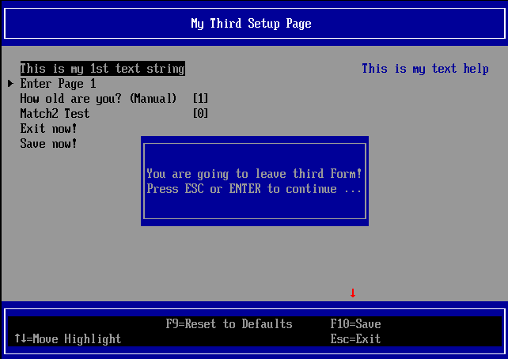
1. Background Introduction 1. CreatePopup API
CreatePopup API defined in UefiLib.
Draw the popup dialog by this API, not through Setup Browser.
May not consistent with browser color configuration.
Directly get user input from user pressed key.
Sample code:
do {
CreatePopUp (EFI_LIGHTGRAY | EFI_BACKGROUND_BLUE, &Key, String1, String2, NULL);
} while ((Key.UnicodeChar != CHAR_CARRIAGE_RETURN) && (Key.UnicodeChar != CHAR_CARRIAGE_ESC));

Slide 4
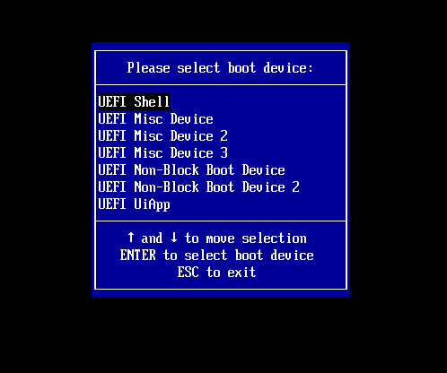
1. Background Introduction 2. BootManagerMenuApp
BootManagerMenuApp is a simplify UI to select boot options.
BootManagerMenuApp itself draw the UI, not through setup browser.
May not consistent with browser color configuration
Directly get user input from user pressed key.

Slide 5
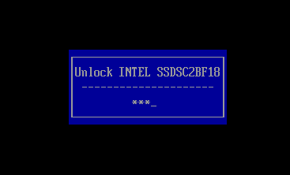
1. Background Introduction 3. Get password in Opal driver
Opal driver get password from user during boot phase.
Opal driver itself draw the UI, not through setup browser.
May not consistent with browser color configuration.
Directly get user input password from user pressed key.

Slide 6
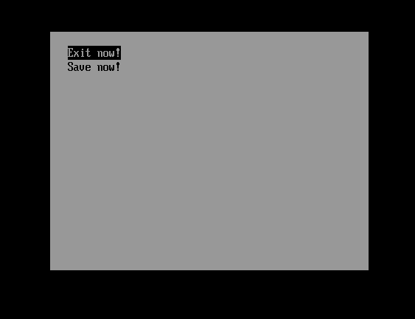
1. Background Introduction 4. Modal Form introduction
A “modal” form is the form which exit it must through user select one option in it, can’t exit through ESC.
Examples of modal forms use cases include:
Error messages
Confirmation dialogs
<= Current Modal form UI
PS: Just a sample implementation of modal form.
Not clear description about modal, wait for enhancement when true requirement received.

Slide 7
2. Problem Statement
Problems:
1. Current poor modal form UI
No clear requirement about modal form when create it.
Expected enhancement later when true requirements received.
2. Configuration may not consistence with browser.
Now different drivers use their own color configuration, not consistent with browser configuration.
3. Code redundancy.
Draw dialog code duplicated in different drivers.

Slide 8
3.1 Proposal 1
Proposal:
Solve Problem 1:
Enhance the modal form UI.
Suitable for the popup dialog use case.

Slide 9
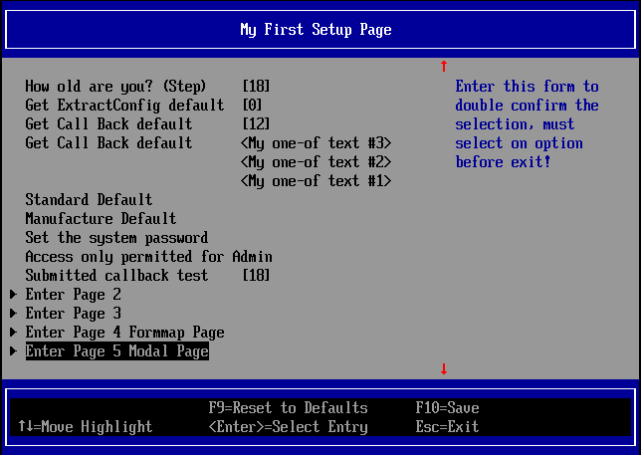
3.1 New Modal Form Proposal
Current modal form
Current normal form
Form Title Field <If string is null, not paint this field>
Form Statement Field
Statement help Field <If string is null, not paint this field>
New modal form

Slide 10
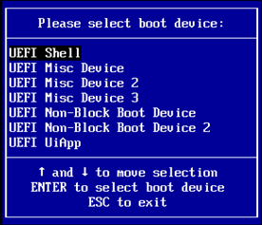
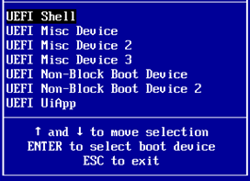
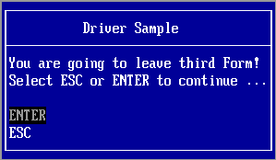
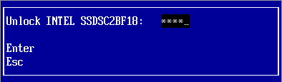
3.1 Different Modal Form style
Case 1. show all the fields
Case 2. Skip show the title field
Case 3. Skip show the help field
Case 4. Skip show the title and help field
If string for this field is NULL, will not show this field

Slide 11
3.1 New Modal Form Proposal
Enhancement:
Support Hotkey for modal form.
Analysis:
Spec just claim that form exit must need user interactive.
Current implementation just base on this to reject hotkey support.
User press hotkey also belong to user interactive, so we can enable hotkey for modal form.
OS also support hotkey for modal form style window.

Slide 12
3.2 Proposal 2
Proposal:
Solve Problem 2 & 3:
Create new API for popup dialog, implement it by modal form.

Slide 13
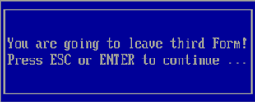
3.2 New Popup Dialog API Proposal
Current:
New Design:
VOID
EFIAPI
CreatePopUp (
IN UINTN Attribute,
OUT EFI_INPUT_KEY *Key, OPTIONAL
...
)
Sample code:
do {
CreatePopUp (
EFI_LIGHTGRAY | EFI_BACKGROUND_BLUE,
&Key,
L"",
L"EfiVarstore value has been submitted!",
L"Press ESC or ENTER to continue ...",
L"",
NULL
);
} while ((Key.ScanCode != SCAN_ESC) && (Key.UnicodeChar != CHAR_CARRIAGE_RETURN));
EFI_STATUS
EFIAPI
HiiGetUserSelection (
IN CHAR16 **Messages,
IN EFI_INPUT_KEY *HotKeyArray,
OUT EFI_INPUT_KEY *RetKey
)
Sample Code:
Messages[0] = L"You are going to leave third Form!";
Messages[1] = L"Select ENTER to leave, Select ESC to stay here";
Messages[2] = NULL;
HotKey[0].ScanCode = SCAN_NULL;
HotKey[0].UnicodeChar = CHAR_CARRIAGE_RETURN;
HotKey[1].ScanCode = SCAN_ESC;
HotKey[1].UnicodeChar = CHAR_NULL;
HotKey[2].ScanCode = SCAN_NULL;
HotKey[2].UnicodeChar = CHAR_NULL;
Status = HiiCreatePopUpEx (
Messages,
HotKey,
&Key
);

Slide 14
4. Solution Evaluation: 1. CreatePopup
Solution:
Use new API HiiGetUserSelection to create popup dialog.
Goodness:
Keep display configuration <color …> consistent.
Remove the duplicate draw the dialog code.
Weakness:
1. No
Current:
After Update:

Slide 15
4. Solution Evaluation: 2. BootManagerMenuApp
Solution:
Use modal form in the application.
Goodness:
Keep display configuration <color …> consistent.
Remove the duplicate draw/manipulate dialog code.
No UI change.
Weakness:
1. No ☺
Current:
After Update:

Slide 16

4. Solution Evaluation: 3. Get password in Opal driver
Solution:
Use modal form in the opal driver.
Goodness:
Keep display configuration <color …> consistent.
Remove the duplicate draw/manipulate dialog code.
Weakness:
The UI changed.
Must exit this dialog through select “Enter” or “Esc”
Current:
After Update:

Slide 17
End

Slide 18

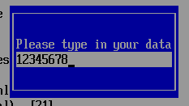

3.1 New Modal Form Proposal
Enhancement:
Support directly input value for string/password op-code.
Current implementation working modal:
Step 1: Press “Enter” to popup dialog to let user input
Step 2: User input the value in the popup dialog.
Step 3: User press “Enter” when finish input.

